Slide 1


SDP
LECTURE
The Factory Method Pattern
Software Design Patterns
Diploma in IT
Year 2 (2024/25), Semester 4
6.1
Notes:
Hi everyone! The next design pattern is called the Factory Method design pattern, and this is our first creational pattern that handles creating objects. Let’s see how this one works.

Slide 2
Example Problem - PizzaHot
PizzaHot is a chain of pizza stores in USA
All pizzas must go through the same steps:
Prepare – arrange the ingredients
Bake
Cut
Put in box
Different types of pizza will be prepared differently
Notes:
So there is this chain of pizza stores in the United States called PizzaHot (no copyright infringement), and we are developing a system that handles pizza orders. Before a pizza can be sold, it must || go through a sequence of 4 steps. First, the pizza must be prepared by arranging the ingredients, which may involve kneading the dough and adding stuff like sauce, cheese and toppings. Next, the pizza must be baked. Once baked, it will be cut into pieces, and finally it will be put in a box. We assume this 4-step process is the same for every pizza; the only difference || is step 1, the preparation step, where different pizzas will use different combinations of ingredients.

Slide 3
Initial PizzaStore Class
public class PizzaStore {
public Pizza orderPizza() {
Pizza pizza = new Pizza();
pizza.prepare();
pizza.bake();
pizza.cut();
pizza.box();
return pizza;
}
}
Notes:
Sounds simple enough, so let’s just bash out a PizzaStore class that represents one of our PizzaHot stores. Here is our initial code that declares a PizzaStore class. The PizzaStore has || one method called orderPizza() that returns a Pizza object. In this method, we first create a || new Pizza object called pizza. Then we follow our 4-step procedure by calling the prepare(), bake(), cut() and box() methods of the pizza object. Finally, we return pizza. This code works if we only have one type of pizza, but of course we have more than that. So how do we handle multiple different types of pizza?

Slide 4
Different Pizza Types
public Pizza orderPizza(string type) {
Pizza pizza;
if (type == "cheese")
pizza = new CheesePizza();
else if (type == "hawaiian")
pizza = new HawaiianPizza();
...
pizza.prepare();
pizza.bake();
pizza.cut();
pizza.box();
return pizza;
}
We make Pizza an abstract class
Must be changed whenever we add or remove new pizza types.
We expect this to stay the same for any pizza
Notes:
Well, we could make the orderPizza() method more advanced, like || this. In this version, we add a || string parameter called type to the orderPizza() method, and depending on the string, we will make different types of pizzas. For example, if the string is || “cheese”, we will make a CheesePizza, and if it is “hawaiian”, we will make a HawaiianPizza, and so on. Of course, we will then make || Pizza an abstract class, and have the specific types of pizza like CheesePizza or HawaiianPizza inherit from the Pizza base class. The rest of the code remains the same – we call pizza.prepare(), bake(), cut() and box(), and depending on the type of pizza, polymorphism will call the corresponding versions of these methods.
This seems to do the job, but it’s not exactly closed for modification. Every time we add or remove a new pizza type, we will have to change this code. Also, this seems to violate our principle of not coding to implementations, since we are coding to specific types of pizza instead of an interface. So how can we improve this code? Let’s go back to our basic principle of encapsulating what changes. In this scenario, we can identify that || this part of the code will likely to change a lot whenever we add or remove pizza types, but || this 4-step process probably won’t change since people have been making pizzas this way for ages. So let’s encapsulate the part that changes into a new class.

Slide 5
Let’s Encapsulate What Changes
Put object creation into a separate class
public class SimplePizzaFactory {
public Pizza createPizza(string type) {
Pizza pizza;
if (type == "cheese")
pizza = new CheesePizza();
else if (type == "hawaiian")
pizza = new HawaiianPizza();
...
return pizza;
}
}
Notes:
The part that changes is in charge of creating objects. We can put that into a separate class that we will call || the SimplePizzaFactory class. This class has a single method called || createPizza() that takes a string called type as a parameter and returns a Pizza object. We copy and paste the if-else statements from our previous code here, and our PizzaStore class can call the createPizza method to create the Pizza objects…

Slide 6
Using the Simple Factory
public class PizzaStore {
private SimplePizzaFactory factory;
public PizzaStore(SimplePizzaFactory factory) { this.factory = factory;
}
public Pizza orderPizza(string type) {
Pizza pizza = factory.createPizza(type);
pizza.prepare();
pizza.bake();
pizza.cut();
pizza.box();
return pizza;
}
}
Notes:
…Like this. We add a || reference to a SimplePizzaFactory called factory, and initialize this in the constructor of PizzaStore. Then the orderPizza() method can delegate the creation of the pizza to the SimplePizzaFactory object by || calling factory.createPizza() along with the string denoting the type. Once we get the correct Pizza object, we will call prepare(), bake(), cut() and box() as usual. With this design, we have decoupled the PizzaStore from adding and removing pizza types, placing them in the SimplePizzaFactory instead.

Slide 7
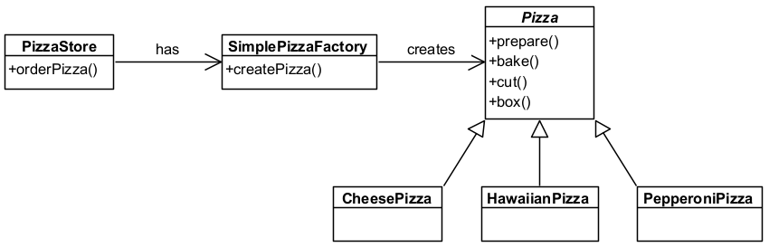
Simple Factory
Simple Factory is not really a design pattern
But it is not a bad start…
Notes:
Here is the class diagram representing this design. Each || PizzaStore has a reference to a SimplePizzaFactory object, which is in charge of creating different types of Pizzas. The || Pizza class is an abstract class, and different types of pizza with their own prepare() methods can inherit from it. This design is known as the Simple Factory, but sorry, this is || not really a design pattern. It’s essentially a straightforward application of “encapsulate what changes” by putting object creating into a separate class, but just using Simple Factory has quite a few limitations. That being said, it’s not a bad start. Let’s build on it by making our scenario a little bit more complex.

Slide 8
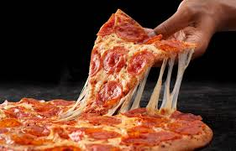
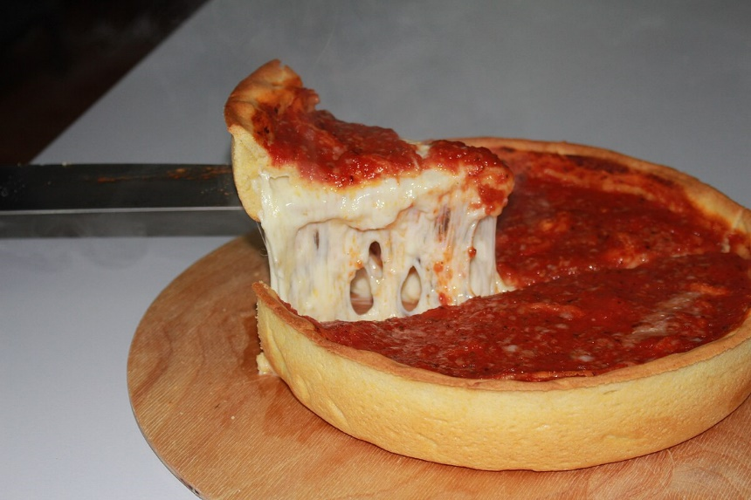
New Requirement - Franchising
PizzaHot is opening shops in different cities
Different cities have different styles of pizza
New York Style Pizza
thin, crispy crust
Reggiano cheese
Marinara sauce
Chicago Style Pizza
Thick crust
Mozzarella cheese
Plum tomato sauce
Notes:
The reason our example is situated in the US is because we want to introduce the added requirement of regional specialties. Unlike a little red dot like Singapore, the United States is huge and contains many cities, and different cities actually have different styles of pizza. For example, || Singaporean pizza is similar to New York style pizza, with a thin, crispy crust, Parmesan Reggiano cheese and marinara sauce, but in the state of Chicago, they have something called “deep dish pizza” that looks like || this. Chicago style pizza has a thick crust, it uses Mozzarella cheese, and their sauce is a plum tomato sauce. Now, you can have, say, a pepperoni pizza in either style, and both will have similar toppings, but the final product is quite different.

Slide 9
Let’s Make PizzaStore abstract
public abstract class PizzaStore {
public Pizza orderPizza(string type) {
Pizza pizza = createPizza(type);
pizza.prepare();
pizza.bake();
pizza.cut();
pizza.box();
return pizza;
}
protected abstract Pizza createPizza(string type);
}
Notes:
How would we handle these regional differences? Well, what this means is that there are actually different types of PizzaStores, so let’s make a PizzaStore base class like || this, and then we can create subclasses of this base class for each region. Since we never want a PizzaStore object, we should make this base class || abstract. As usual, we have an orderPizza() method that returns different pizzas depending on the string parameter. To create the correct type of pizza, we call the || createPizza() method and throw in the string parameter. This method is an || abstract method in the PizzaStore class, and each subclass of PizzaStore will override this with their own createPizza() implementation.

Slide 10
Regional PizzaStore Subclasses
Create a subclass of PizzaStore for each region
public class NYStylePizzaStore: PizzaStore {
public override Pizza createPizza(string type) {
if (type == "cheese")
return new NYStyleCheesePizza();
else if (type == "hawaiian")
return new NYStyleHawaiianPizza();
...
}
}
Notes:
So now we can create a subclass of PizzaStore for each region. For example, a New York style PizzaStore may look like || this. It uses the default version of orderPizza() from the base PizzaStore class, but it || overrides the createPizza() method with its own version. Notice that each concrete pizza object is a New York style version of the pizza, and we can do the same for other regional stores. And with different types of pizza, of course we should declare a base class and have specific pizzas inherit from it, so let’s do that.

Slide 11
Pizza Abstract Class
public abstract class Pizza {
protected string name;
protected string dough;
protected string sauce;
protected List<string> toppings =
new List<string>();
public virtual void prepare() {
Console.WriteLine($"Preparing {name}");
Console.WriteLine($"Tossing dough: {dough}");
Console.WriteLine($"Adding sauce: {sauce}");
Console.WriteLine("Adding toppings:");
foreach (string topping in toppings)
Console.WriteLine($" - {topping}");
}
Notes:
This is the start of our abstract Pizza class. The attributes for the class will be stuff that is in every pizza, like the name, dough, sauce and a list of toppings. Then we need a method for each of the 4 steps. The prepare() method will print out the correct strings based on the values of the attributes, including listing out all the toppings. And just in case there is a specific type of pizza that needs to have a different version of prepare(), we mark it as || virtual.

Slide 12
Pizza Abstract Class (cont.)
public virtual void bake() {
Console.WriteLine("Baking the pizza in an
oven.");
}
public virtual void cut() {
Console.WriteLine("Cutting the pizza into
triangles.");
}
public virtual void box() {
Console.WriteLine("Placing the pizza in a
PizzaHot box.");
}
}
Notes:
And we do the same for bake(), cut() and box(). Just like for prepare(), we make all of these virtual as well in case there is a pizza that does things differently.

Slide 13
Let’s Make PizzaStore abstract
public class ChicagoStyleCheesePizza: Pizza {
public ChicagoStyleCheesePizza()
{
name = "Chicago Style Deep Dish Cheese Pizza";
dough = "Extra Thick Dough Crust";
sauce = "Plum Tomato Sauce";
toppings.Add("Shredded Mozzarella Cheese");
}
public override void cut() {
Console.WriteLine("Cutting the pizza into
square slices.");
}
}
Notes:
Let’s create a Chicago style cheese pizza. To do so, we create a ChicagoStyleCheesePizza class, which || inherits from the Pizza base class. This means that it inherits the prepare(), bake(), cut() and box() methods, and will use the default versions of these methods if it doesn’t override them. In the constructor, we || initialize the attributes with the correct values. It turns out that Chicago style cheese pizza is cut into squares instead of the usual triangles, so we can || override the cut() method accordingly, but we can use the default versions of prepare(), bake() and box().

Slide 14
Let’s Test It
PizzaStore chicagoStore = new ChicagoStylePizzaStore();
chicagoStore.orderPizza(“cheese”);
Preparing Chicago Style Deep Dish Cheese Pizza
Tossing dough: Extra Thick Dough Crust
Adding sauce: Plum Tomato Sauce
Adding toppings:
- Shredded Mozzarella Cheese
Baking the pizza in an oven.
Cutting the pizza into square slices.
Placing the pizza in a PizzaHot box.
Notes:
Hooray, we can now have some pizza! Let’s || create a new ChicagoStylePizzaStore called chicagoStore, and order a cheese pizza from it. Since chicagoStore is a PizzaStore, C# will look at the PizzaStore implementation of the orderPizza() method, which calls the createPizza() method. Since createPizza() is abstract, it will check the subclass implementation, and so this ChicagoStylePizzaStore version of createPizza() will return a ChicagoStyleCheesePizza object. Next, the orderPizza method will call the prepare(), bake(), cut() and box() methods of the ChicagoStyleCheesePizza object, resulting in || this output. All of this uses the default version of these methods from the Pizza class, except || cut(), because ChicagoStyleCheesePizza has overridden cut() to make square slices instead of triangular ones. And now we can all have some yummy pizza.

Slide 15
The Factory Method Pattern
Notes:
And this is what is known as the Factory Method design pattern. Here’s a formal introduction.

Slide 16
Definition
The Factory Method Pattern:
Defines an interface for creating an object, but lets the subclasses decide which class to instantiate
Lets a class defer instantiation to subclasses
Also known as
Virtual Constructor
Notes:
The Factory Method pattern defines an interface for creating an object, but it does not know what objects will be created. Instead, what is created is decided by the subclass that is chosen, and the creation process is delegated to the subclass object. This pattern is also known as || the Virtual Constructor pattern.

Slide 17
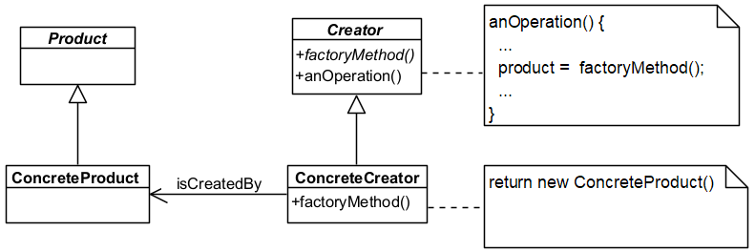
The Factory Method Pattern
Notes:
This is the class diagram for the Factory Method pattern. We have an || abstract class called Product, which is the base object that we want to create. We have || ConcreteProducts that inherit from Product and can optionally override default methods in the Product. Next, we have another abstract class called the || Creator. This class contains implementations for all the methods to manipulate products, except the factory method, which is declared as an abstract method. There is usually an operation in the Creator || that calls the factory method to create a ConcreteProduct object. Finally, the || ConcreteCreator is a subclass of Creator, so it must implement the factory method, which || returns some ConcreteProduct. Note that in this design pattern, the only classes that have the knowledge to create ConcreteProducts are the ConcreteCreators, you are not supposed to create ConcreteProducts any other way.

Slide 18
Key Participants
Product
Defines interface for objects that the factory method creates.
ConcreteProduct
Implements the Product interface.
Creator
Declares the factory method, which returns an object of type Product.
May also define a default implementation of factory method that returns a default ConcreteProduct
ConcreteCreator
Overrides the factory method to return ConcreteProduct object
Notes:
In summary, the Factory Method pattern has 4 key participants. The || Product defines an interface for objects that the factory method creates, and may include default implementations for certain methods.
Each class that implements the Product is called a || ConcreteProduct, which may or may not override methods defined in Product.
The || Creator class declares the factory method that returns a Product object. This is often declared as an abstract method, but it is also possible to || define a default implementation of the factory method that returns a default ConcreteProduct.
Finally, a || ConcreteCreator will override the factory method to return a ConcreteProduct object.

Slide 19
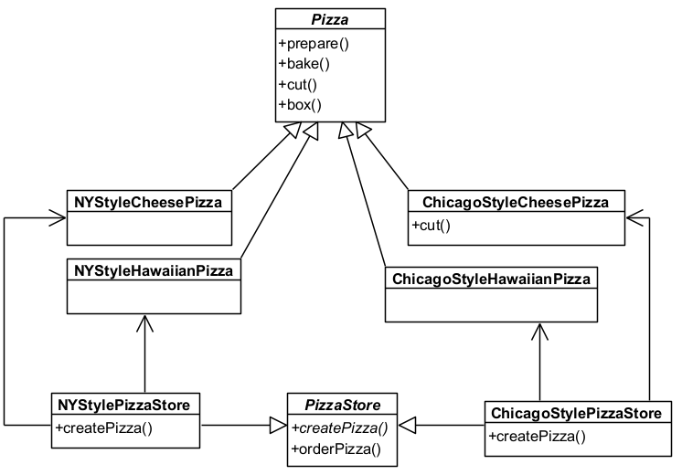
Applying Factory Method to PizzaHot
Product
ConcreteProducts
ConcreteCreator
Creator
ConcreteCreator
Notes:
Let’s see how we applied the Factory Method pattern to our PizzaHot application. We have the abstract class Pizza, which is our || Product. In this case, we defined default versions of prepare(), bake(), cut() and box() that ConcreteProducts can use, although they can override these methods as required. We then have a bunch of || ConcreteProducts representing different styles and types of pizza. In this class diagram, we see that the ChicagoStyleCheesePizza has its own version of cut(), but for all other cases the ConcreteProducts made use of the default methods. Next, the PizzaStore abstract class is || the Creator. The factory method is called createPizza() and is declared as abstract, and we have another method called orderPizza() that calls createPizza() to get a Pizza object, and then prepares, bakes, cuts and boxes it. Finally, we have currently two || ConcreteCreators representing New York and Chicago style pizza stores, which each will return ConcreteProducts of their corresponding types. Not too difficult, right?

Slide 20
What Have We Achieved?
Subclasses decide what objects to create
E.g., the orderPizza() method is fixed, but it can create both NY and Chicago style pizzas depending on the type of PizzaStore
Avoids having to bind specific classes into your code
The code only deals with the Product interface and can work with any ConcreteProduct
Notes:
So that’s the Factory Method design pattern. What have we achieved? Well, we have || decoupled the creation of specific pizzas from the base PizzaStore class. Depending on whether we assign a New York or Chicago style pizza store to our PizzaStore object, we can call its orderPizza() method and it will use polymorphism to return the correct style of pizza for us. We have also || avoided having to bind specific classes to our code because we have used a Product interface, so our code can work with any ConcreteProduct instead of having to handle specific ones.

Slide 21
Things to Note
The factory method can be abstract or concrete
If it is abstract, the Creator class is also abstract
If it is concrete, it can provide default implementations for the factory method
Parameterized factory methods may not be “type-safe”
E.g., must handle invalid strings
We created a lot of ConcreteProducts
The next lesson offers a solution ☺
Notes:
Here are a few more things to consider. In our example, we made our || createPizza() factory method abstract, but it can also be concrete. There are pros and cons to this. If it is || abstract, this means the Creator class must also be abstract as only abstract classes can have abstract methods. With an abstract Creator class, you will never be able to instantiate a Creator object, which is good since it should only ever be used as a base class for ConcreteCreators. On the other hand, this forces all ConcreteCreators to implement their own version of the factory method. In contrast, we can make || both the Creator class and factory method concrete, thereby providing a default implementation of the factory method. This is convenient if many of the ConcreteCreators have a similar factory method, but it also means that you can create an object of type Creator, which doesn’t really make sense. Still, both versions are valid.
In our example, we used a string parameter called type to control what object is created. This is known as a || parameterized factory method, but the way we did it is not “type-safe”, meaning that we might run into trouble if we put in an unrecognized string as an argument. Now, there are lots of ways to improve type safety, such as returning a special default ConcreteProduct representing “string not found”, or using enumerated types instead of strings, but yes, you do have to handle this in production code.
Some of you might be a little concerned with the || number different types of Pizza types we have created. For each region, we created a separate class for each pizza type, so New York has their own version of cheese, Hawaiian, pepperoni or vegetarian pizzas, and so does Chicago, California or some other region. That’s a lot of subclasses. Well, we have a solution to this…in our || next lesson.

Slide 22
Summary
The Factory Method design pattern
Next: The Abstract Factory design pattern
Notes:
So that was the Factory Method design pattern, which defines an interface for creating an object, but lets subclasses decide which class to instantiate. Now, whenever there are objects with variations that you want to create, this pattern gives a nice way to decouple the creator classes from the product classes. In the next lesson, we will discuss another creational design pattern called the Abstract Factory.
Incidentally, what do you call a factory that only makes okay products? A satisfactory. Byee!

